Slide 1
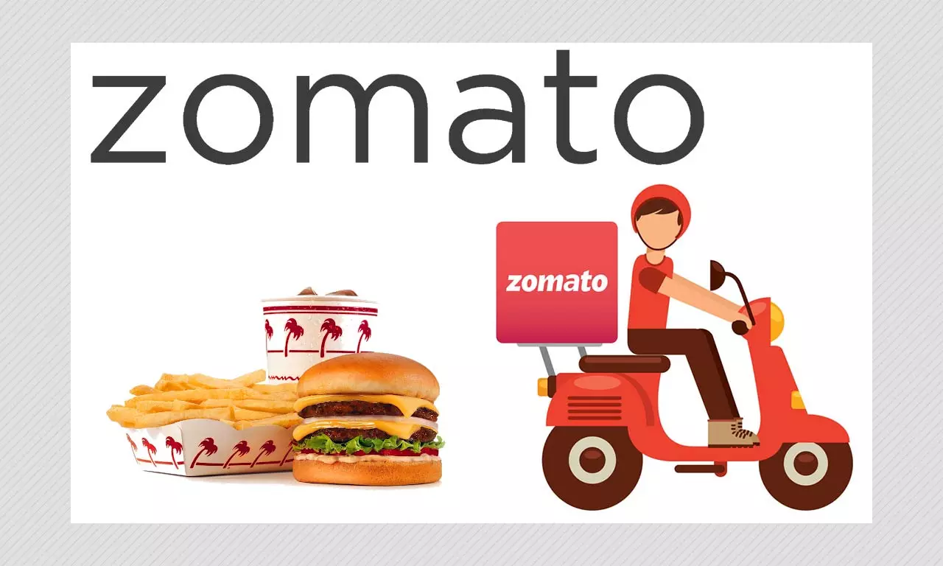
Zomato Analysis

Slide 2

Our Team (Group No:- 05)
Ms. Vaishnavi Vasudeo Sumant
Ms. Srijita Sinha
Mr. Rahul Panjwani
Mr. Sahil Sunil Tawde
Ms. Sabitri Panigrahi
Mrs. Rekha S
Mr. Anmol Dewangan
Ms. Dhanashri Sanjay Bhabad

Slide 3

Project Objective
This project is aimed to understand the cuisines, average ratings, online presence of restaurants in 15 different countries by year, quarter and month basis.
Using the given structured dataset we have created different visualization with the help of KPI’s, Charts & graphs so that we can understand the given tabular dataset in a very simple manner.
Visualization is to be done in the form of dashboards using analytics tools like Excel, PowerBi & Tableau and data analysis in SQL.

Slide 4
Understanding and cleaning the Dataset
Checked all the details of table such column name, data types
Change the formatting of necessary columns and rows.
Checked for duplicate values.
Checked min,max,avg data for votes, rating & currency column.

Slide 5

Implementation of KPI's
Number of Restaurants based on City and Country
Number of Restaurants opening based on Year , Quarter , Month
Count of Restaurants based on Average Ratings
Restaurants by average price
Percentage of Restaurants based on "Has Table booking“ and "Has Online delivery“
Cuisines by Restaurants

Slide 6
KPI 1: Number of Restaurants based on City & Country :-
Total Countries
Total Cities
15
141
Insights :
Here we get the numbers of restaurants which are associated with zomato world wide.
Zomato is available in 15 countries and 141 cities .
New delhi has the most numbers of restaurants with zomato.

Slide 7
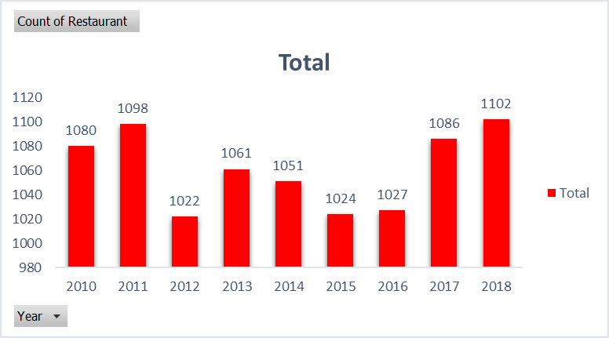
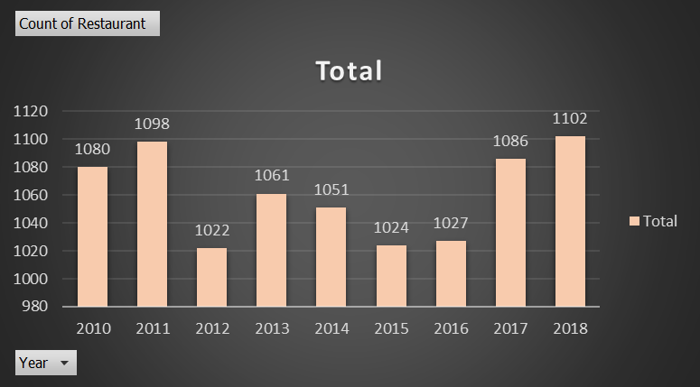
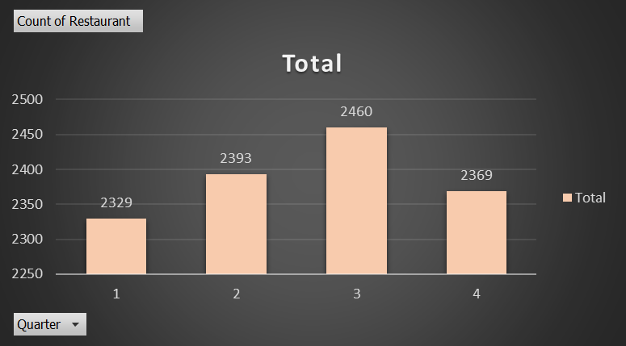
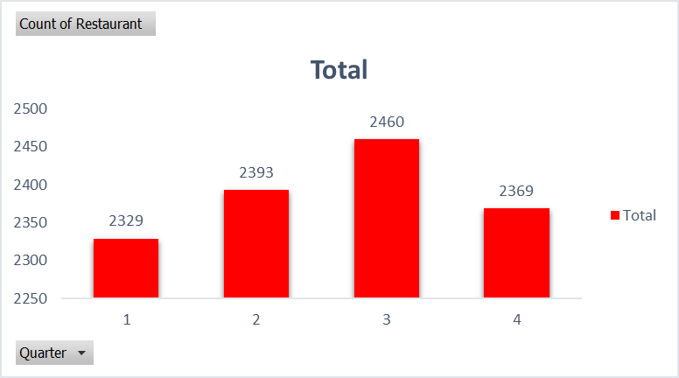
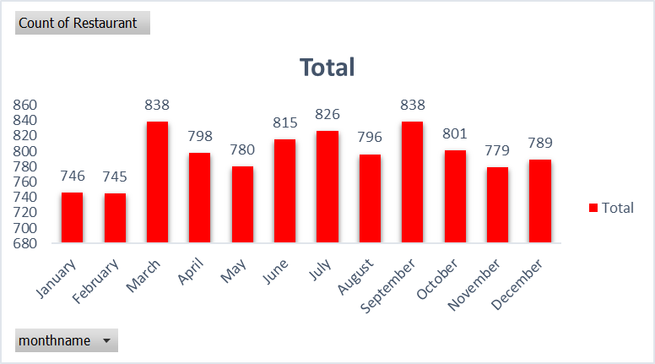
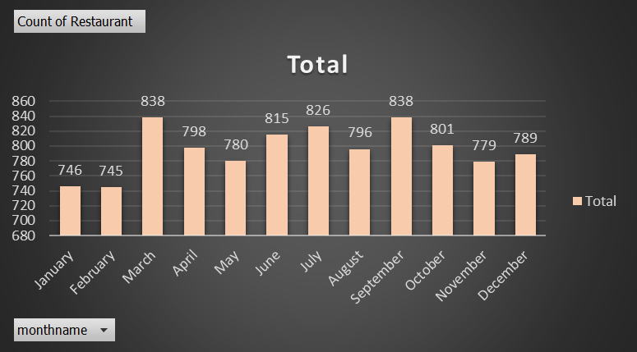
Number of Restaurants opening based on Year, Quarter, Month
No. of Restaurants in Year
Insights :
Here, we can see among 15 countries, total of 9551 restaurants are associated with zomato in the past 9 years.
No. of Restaurants in Quarter
No. of Restaurants in month

Slide 8
KPI 3: Count of Restaurants based on Average Ratings
Insights :
The maximum numbers of restaurants has average ratings of 3 to 4 from the customers.

Slide 9
KPI 4: Restaurants by Average Price
Insights :
Here, from the bar chart we can clearly see that maximum numbers of restaurants are pocket friendly to the customers in the basis of average costs of food ordering.

Slide 10
KPI 5: Percentage of Restaurants based on Has Table booking and Has Online delivery
Insights :
Because of various offers on Here, from both the pie charts it is clear that zomato is doing better business from their food delivery rather than online booking.

Slide 11
KPI 6: Cuisines by Restaurants
Insights :
Here it is clearly visualized that world wide north Indian cuisine is most ordered cuisine from the zomato food delivery app

Slide 12
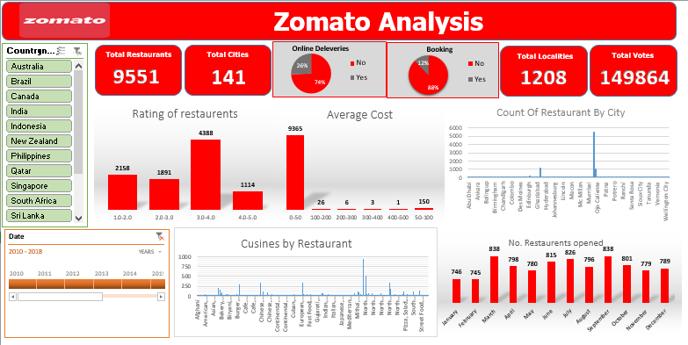
Dashboard in Excel

Slide 13
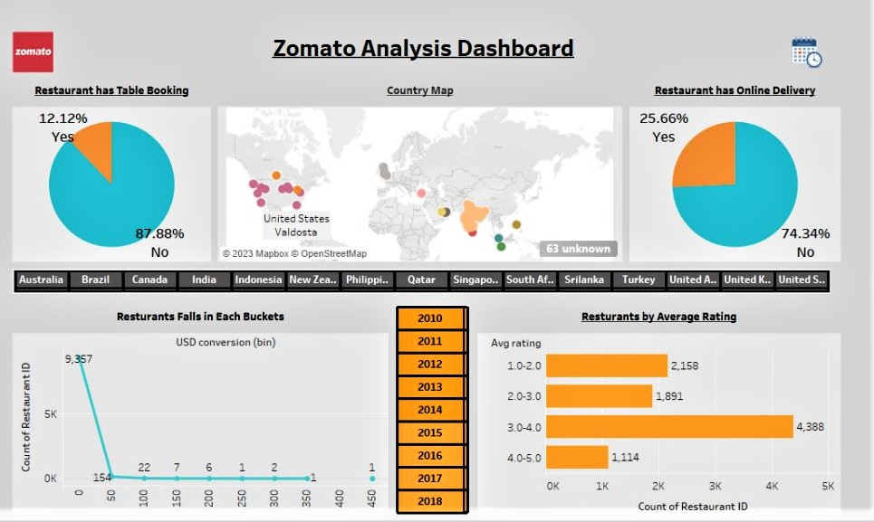
Dashboard In Tableau

Slide 14
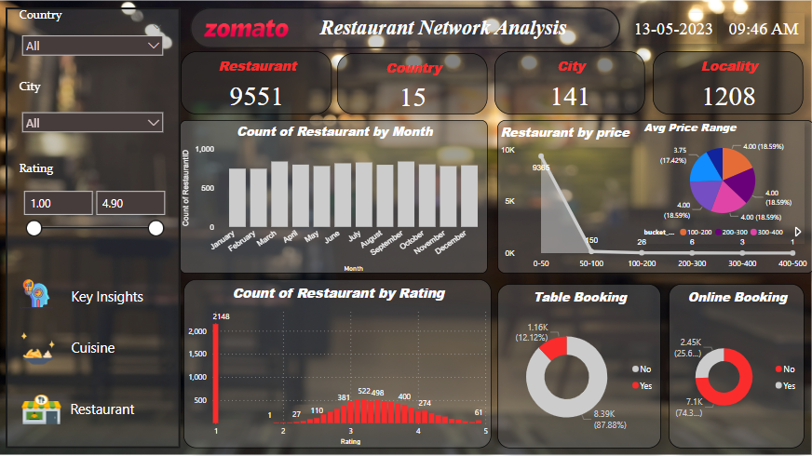
Dashboard in Power BI
Key Insights

Slide 15
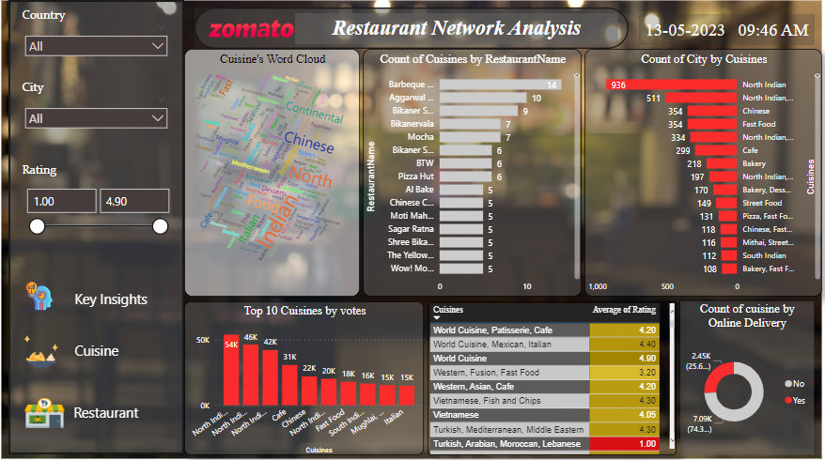
Dashboard in Power BI
Cuisine

Slide 16
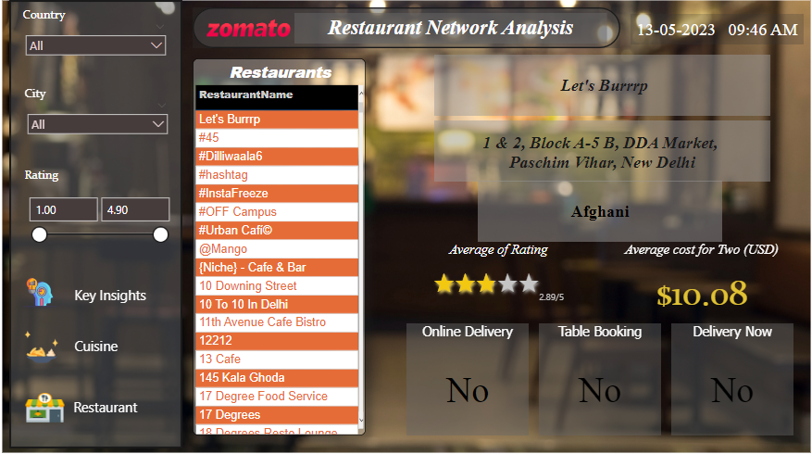
Dashboard in Power BI
Restaurants

Slide 17
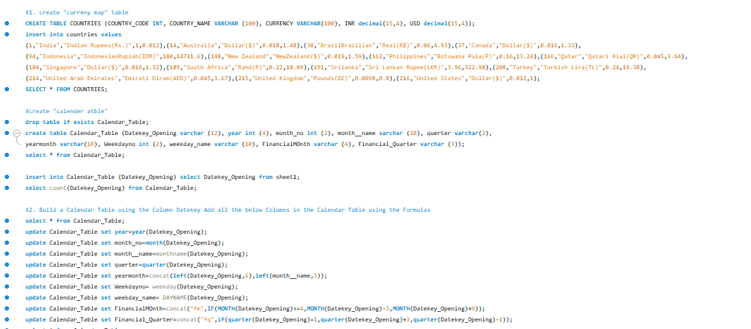
SQL Commands

Slide 18
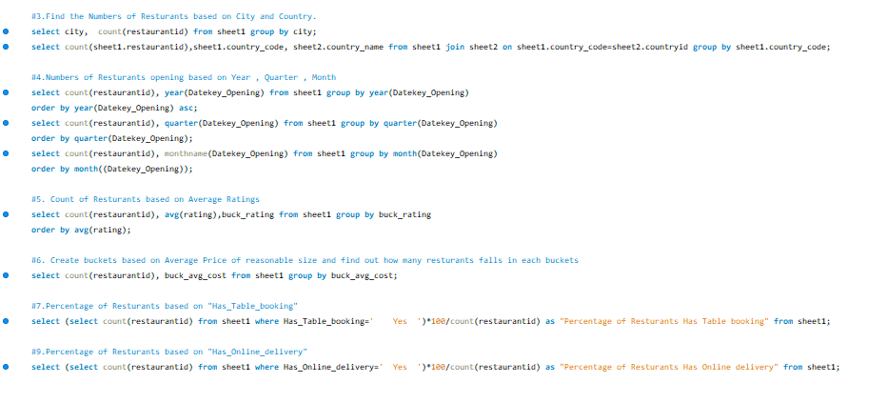
SQL Commands

Slide 19
Conclusion
The basic idea of analyzing the Zomato dataset is to get a fair idea about the factors affecting the establishment of different types of restaurant at different places. Inspite of increasing demand it however has become difficult for new restaurants to compete with established restaurants. Most of them serving the same food.
By the analysis we were able to analyze the presence of Zomato in different countries and cities, the ratings and average cost of the restaurants which play an important role while choosing a restaurant, cuisines offered by the restaurants, etc.
According to this Zomato Dataset, 90.67% of data is related to restaurants listed in India followed by USA.
Restaurants having an online delivery option, Restaurants providing table reservations, Restaurants providing table reservations have significantly higher ratings.
Best moderately priced restaurants with average cost for two < 1000, rating > 4, votes > 4 and provides both table booking and online delivery options to their customer.

Slide 20
Thank
You

